Slide 1
St. Louis Central Corridor West Building Permits
Quarter 3 Report: 2020

Slide 2
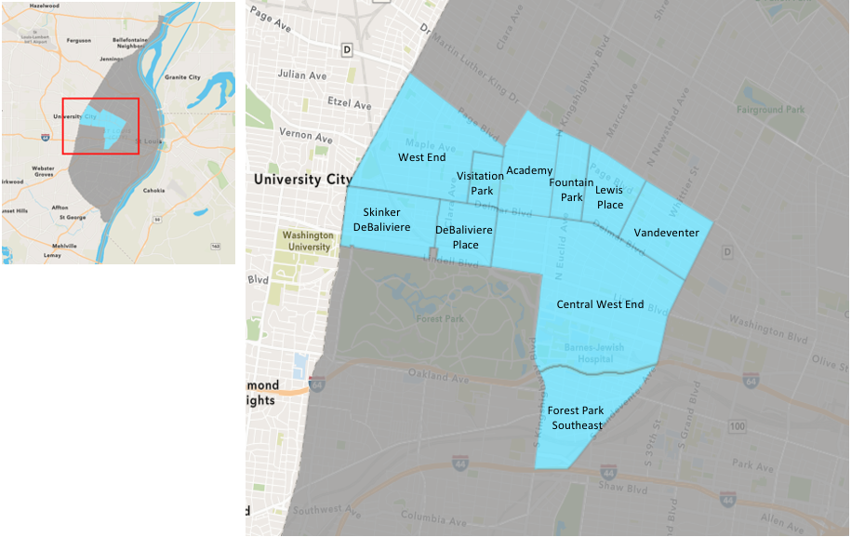
St. Louis Neighborhood Spatial Reference

Slide 3
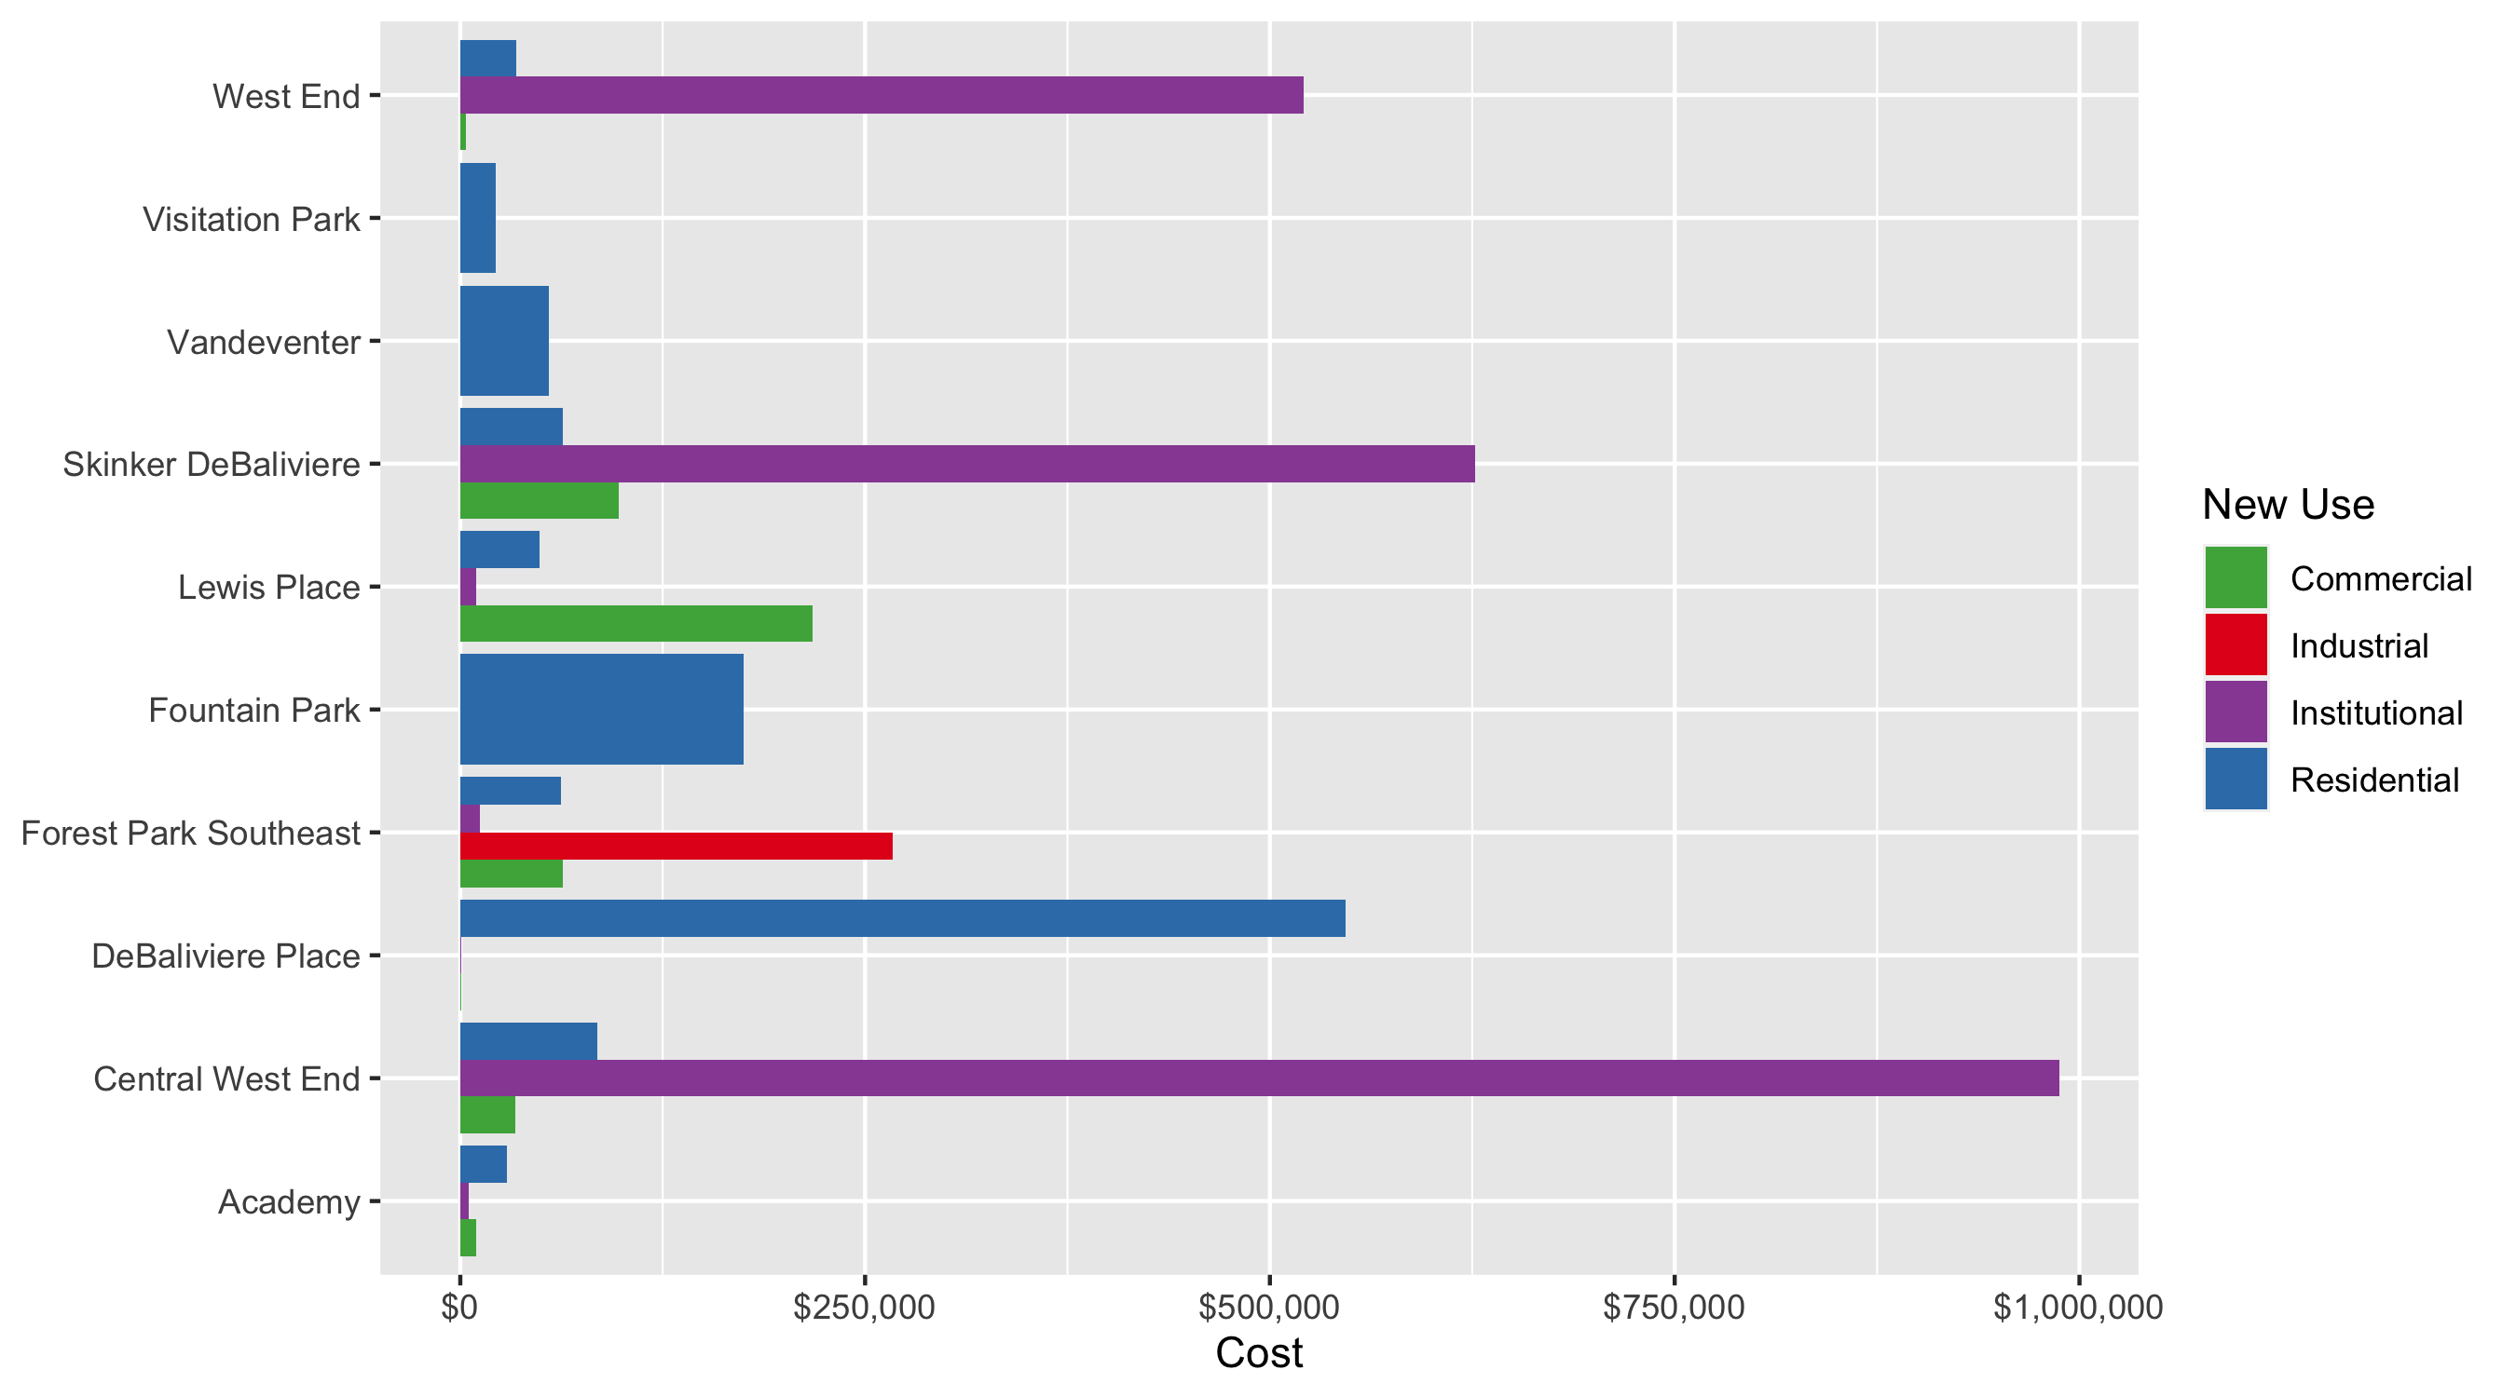
Neighborhood Summary: Average Building Permit Cost

Slide 4
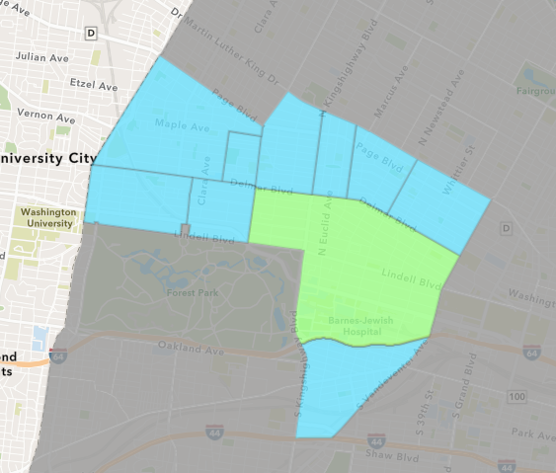
Central West End
Quarter 3 , 2020 Neighborhood Cost Breakdown
Mean: $375,075
Median: $15,665
Range: $500 - $28,000,000

Slide 5
Central West End: Summary Notes
120 building permits in Quarter 3, 2020
-9.77% change compared to Quarter 3, 2019 (133 total building permits)
$375,075: Average building permit cost in Quarter 3, 2020
105.53% change compared to Quarter 3, 2019 ($182,493)

Slide 6
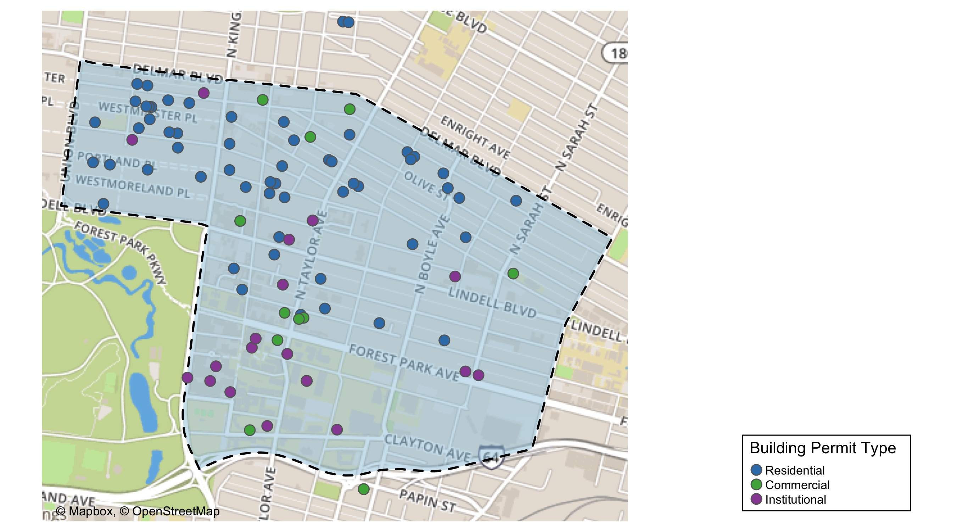
Central West End

Slide 7
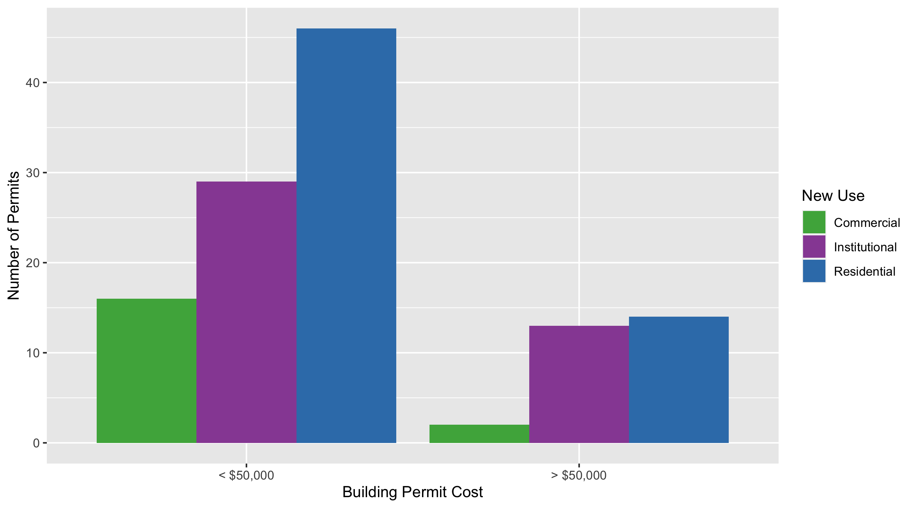
Central West End Permit Use Breakdown

Slide 8
Central West End
Quarter 3, 2020 | Quarter 3, 2020 | Quarter 3, 2020 | Quarter 3, 2020
Permit Use | Average Cost | # of Permits | Total Value of Permits
Commercial | $20,551 | 18 | $369,926
Industrial | $0 | 0 | $0
Institutional | $987,391 | 42 | $41,470,422
Residential | $52,811 | 60 | $3,168,652
Quarter 3 2019 | Quarter 3 2019 | Quarter 3 2019 | Quarter 3 2019
Permit Use | Average Cost | # of Permits | Total Value of Permits
Commercial | $132,924 | 23 | $3,057,250
Industrial | $5,000 | 2 | $10,000
Institutional | $360,756 | 53 | $19,120,082
Residential | $37,895 | 55 | $2,084,245

Slide 9
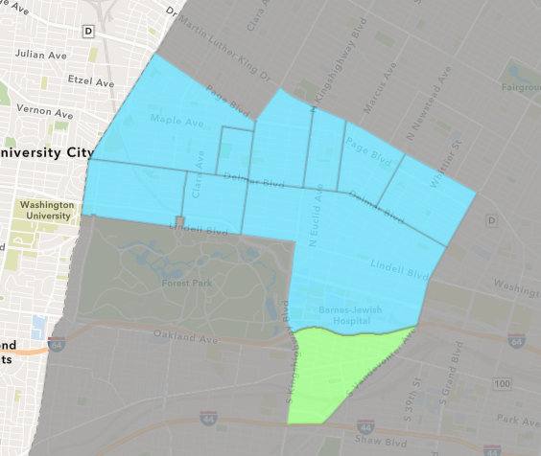
Forest Park Southeast
Quarter 3 , 2020 Neighborhood Cost Breakdown
Mean: $62,228
Median: $10,000
Range: $300 - $600,000

Slide 10
Forest Park Southeast: Summary Notes
42 building permits in Quarter 3, 2020
-10.64% change compared to Quarter 3, 2019 (47 total building permits)
$62,228: Average building permit cost in Quarter 3, 2020
-83.35% change compared to Quarter 3, 2019 ($373,717)

Slide 11
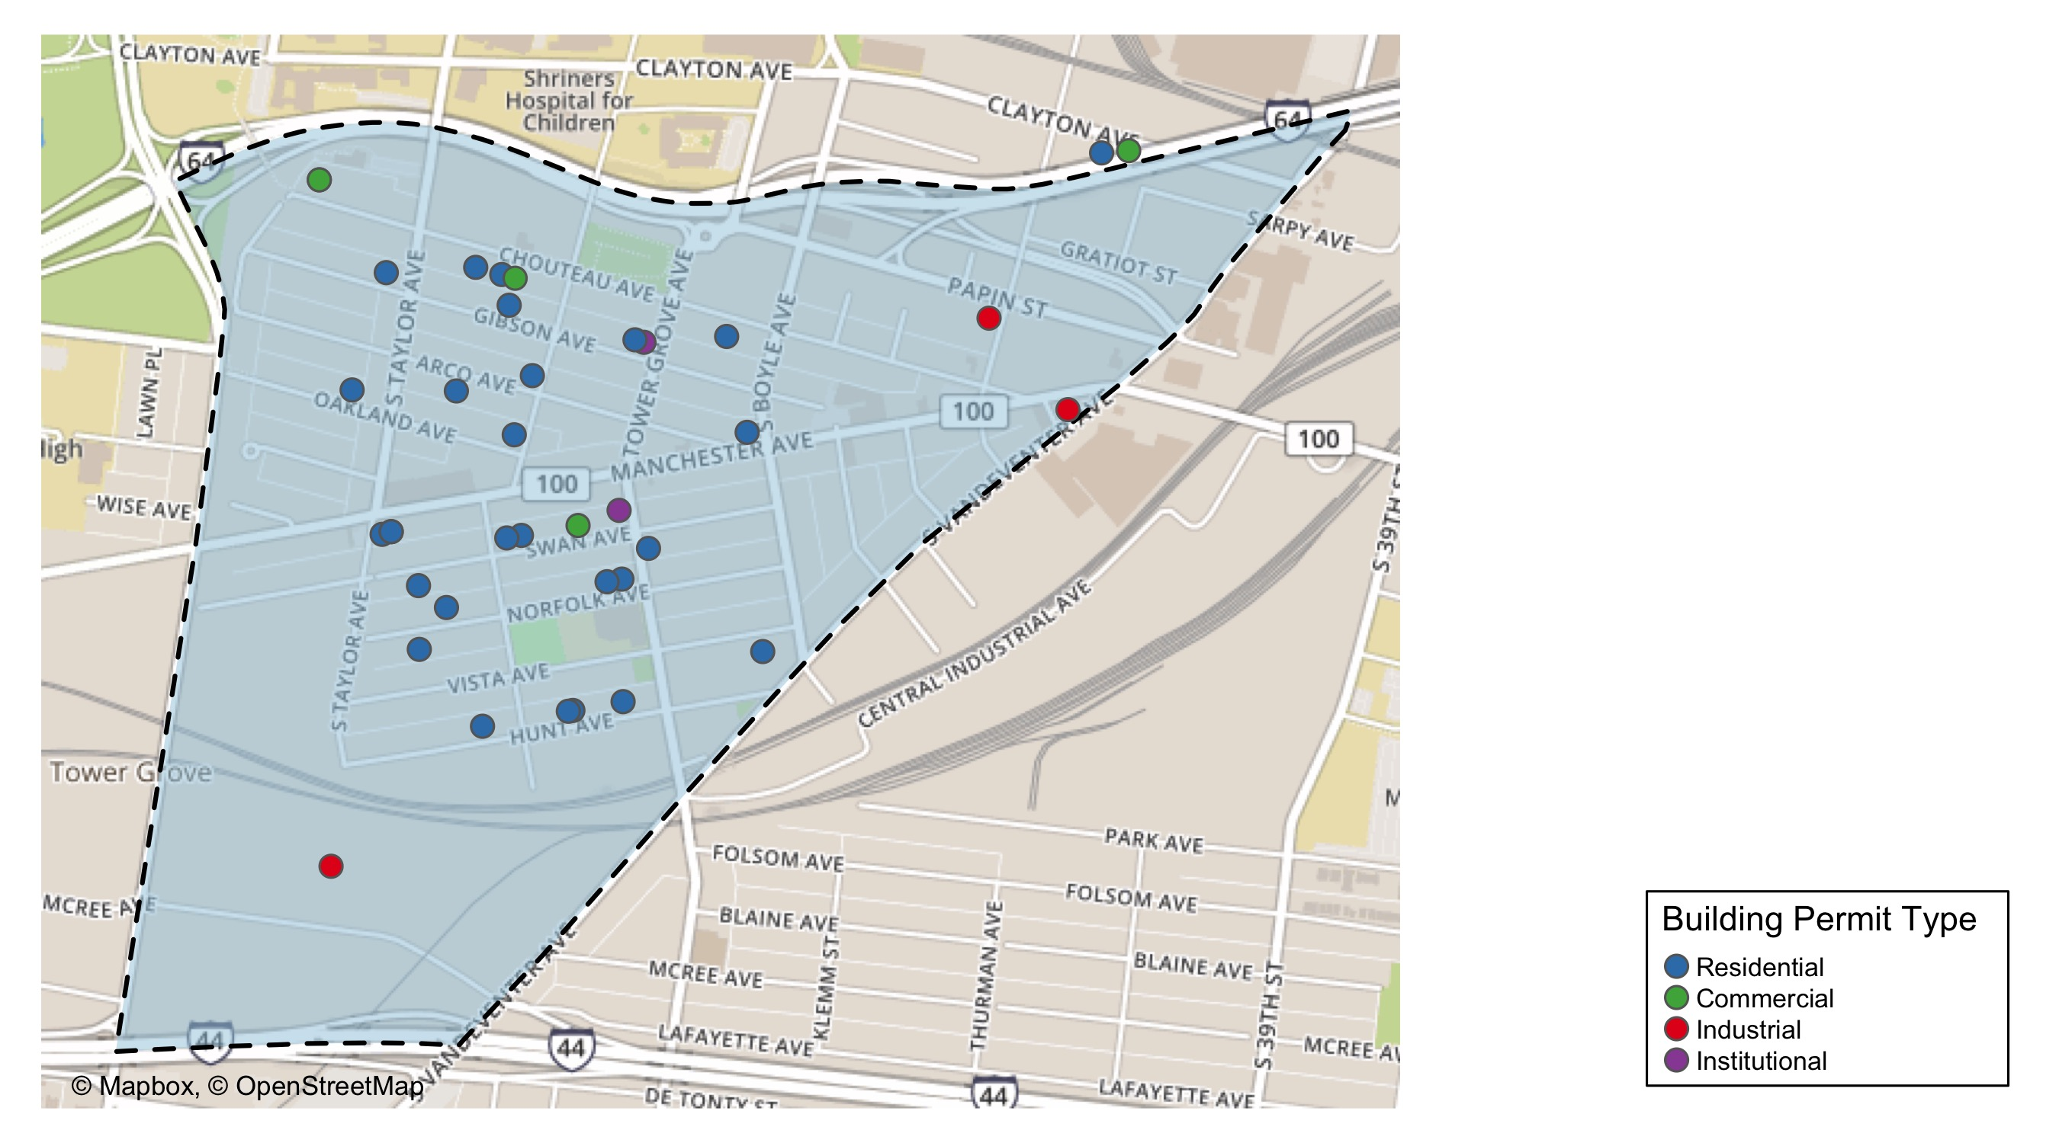
Forest Park Southeast

Slide 12
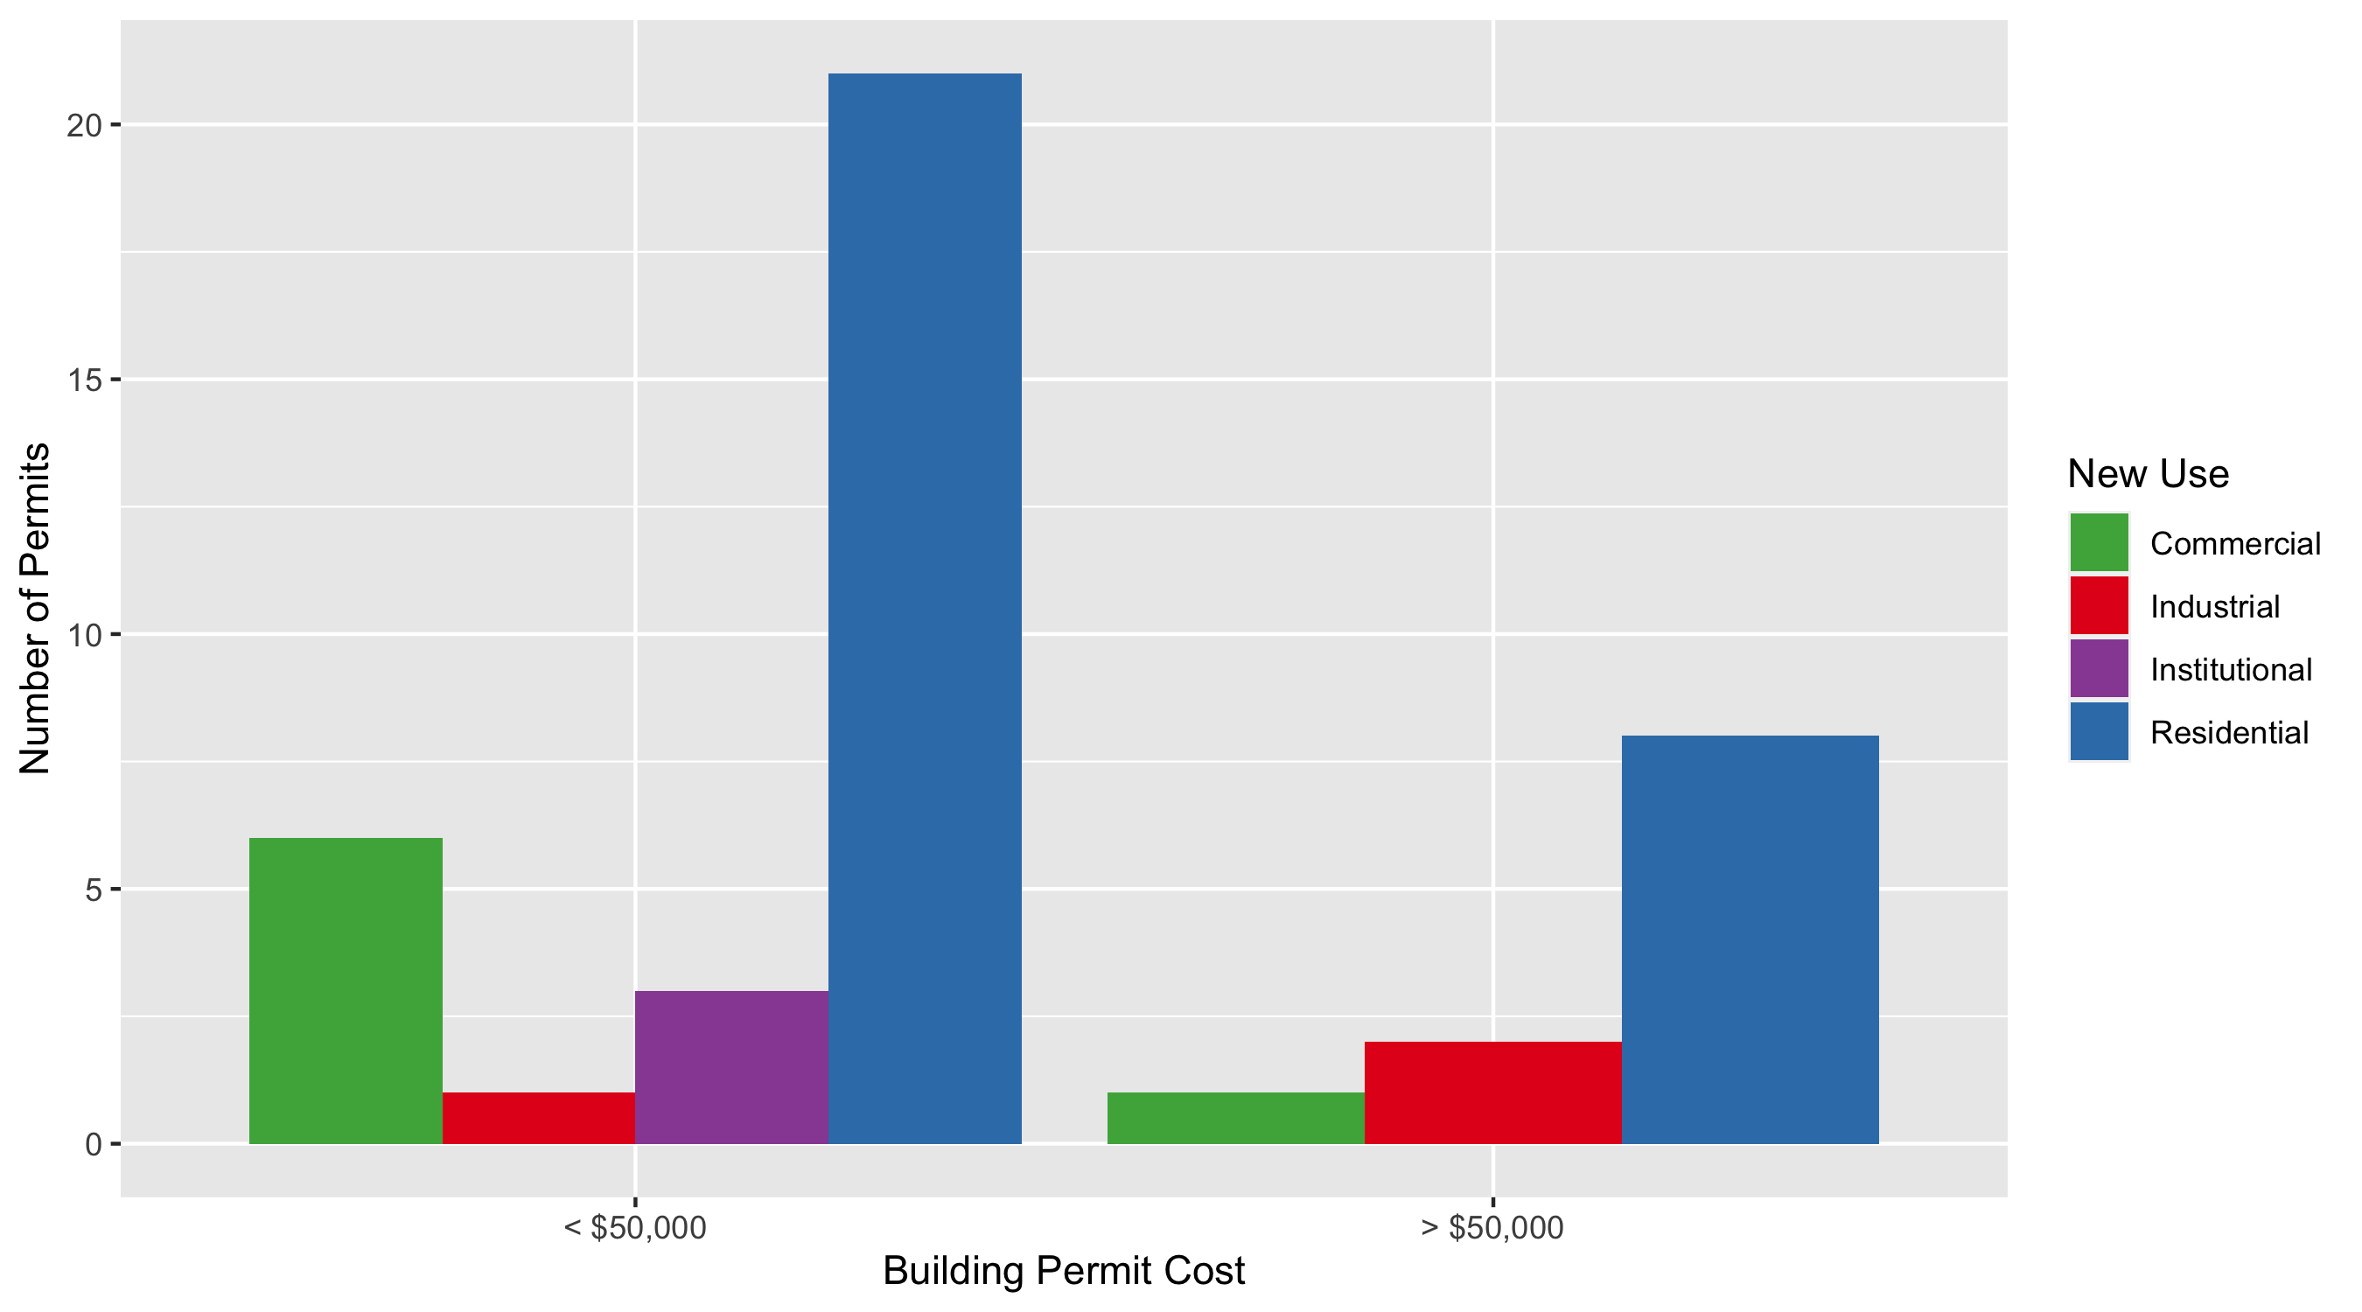
Forest Park Southeast Permit Use Breakdown

Slide 13
Forest Park Southeast
Quarter 3, 2020 | Quarter 3, 2020 | Quarter 3, 2020 | Quarter 3, 2020
Permit Use | Average Cost | # of Permits | Total Value of Permits
Commercial | $63,586 | 7 | $445,100
Industrial | $267,033 | 3 | $801,100
Institutional | $12,330 | 3 | $36,989
Residential | $45,876 | 29 | $1,330,402
Quarter 3 2019 | Quarter 3 2019 | Quarter 3 2019 | Quarter 3 2019
Permit Use | Average Cost | # of Permits | Total Value of Permits
Commercial | $87,766 | 12 | $1,053,195
Industrial | $0 | 0 | $0
Institutional | $1,374,161 | 5 | $6,870,807
Residential | $321,357 | 30 | $9,640,710

Slide 14
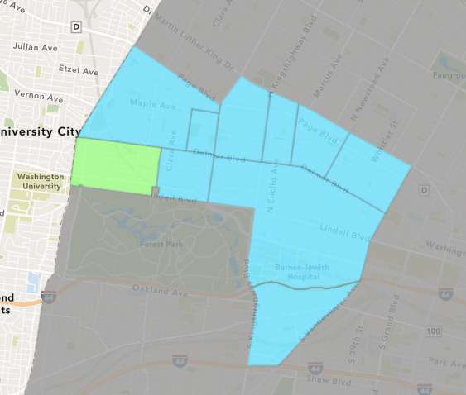
Skinker DeBaliviere
Quarter 3 , 2020 Neighborhood Cost Breakdown
Mean: $134,384
Median: $12,900
Range: $937 - $2,006,500

Slide 15
Skinker DeBaliviere: Summary Notes
35 building permits in Quarter 3, 2020
75.00% change compared to Quarter 3, 2019 (20 total building permits)
$134,384: Average building permit cost in Quarter 3, 2020
319.93% change compared to Quarter 3, 2019 ($32,001)

Slide 16
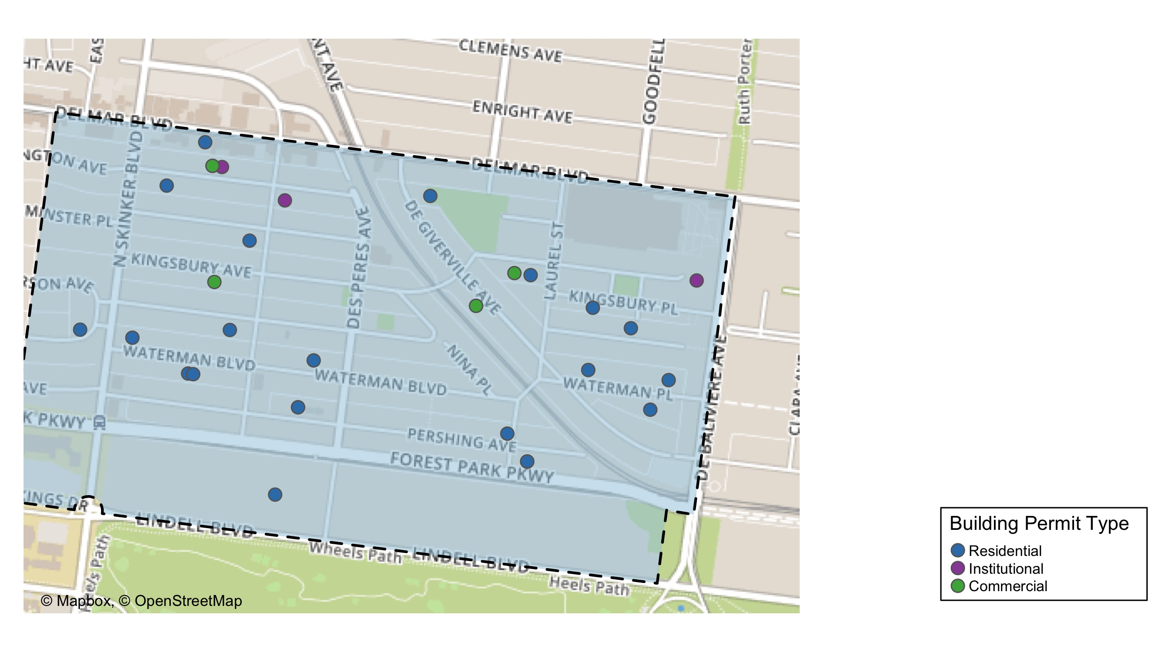
Skinker DeBaliviere

Slide 17
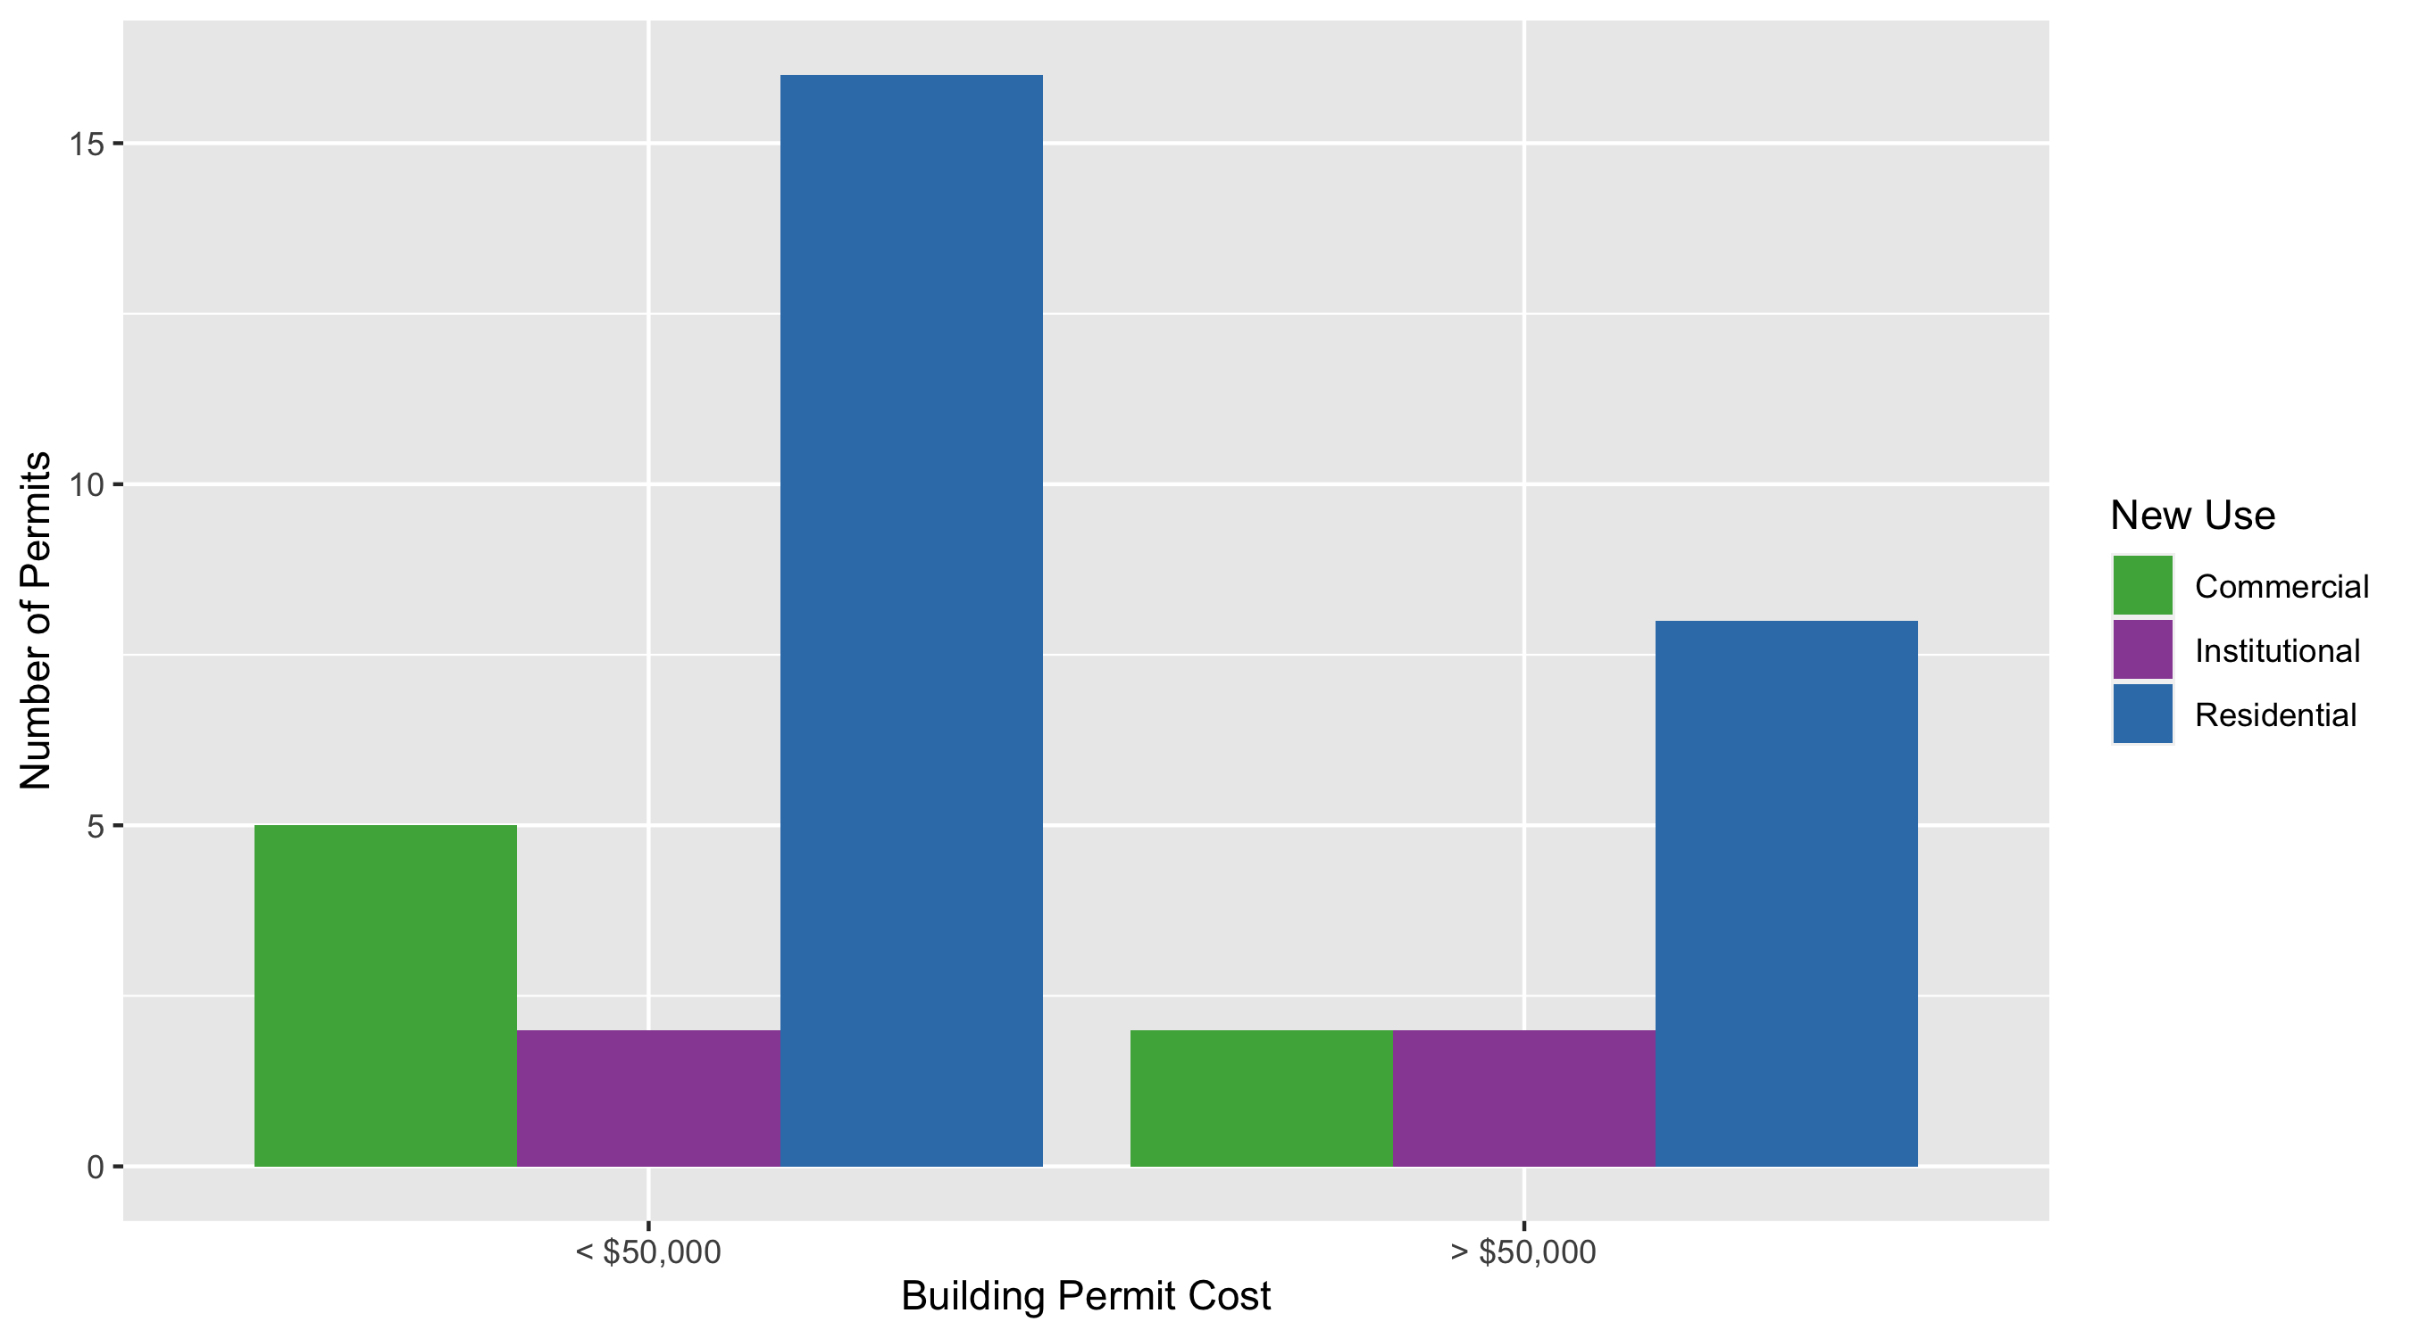
Skinker DeBaliviere Permit Use Breakdown

Slide 18
Skinker DeBaliviere
Quarter 3, 2020 | Quarter 3, 2020 | Quarter 3, 2020 | Quarter 3, 2020
Permit Use | Average Cost | # of Permits | Total Value of Permits
Commercial | $97,584 | 7 | $683,090
Industrial | $0 | 0 | $0
Institutional | $626,500 | 4 | $2,506,000
Residential | $63,098 | 24 | $1,514,364
Quarter 3 2019 | Quarter 3 2019 | Quarter 3 2019 | Quarter 3 2019
Permit Use | Average Cost | # of Permits | Total Value of Permits
Commercial | $25,000 | 1 | $25,000
Industrial | $0 | 0 | $0
Institutional | $78,550 | 2 | $157,100
Residential | $26,937 | 17 | $457,929

Slide 19
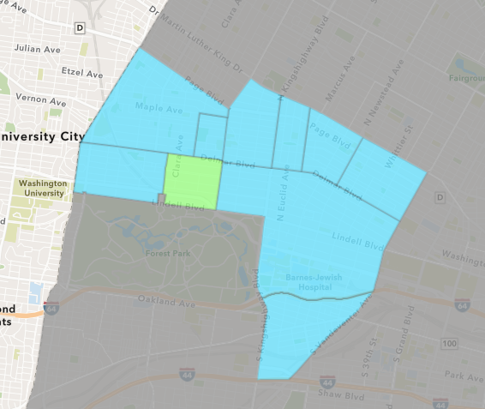
DeBaliviere Place
Quarter 3 , 2020 Neighborhood Cost Breakdown
Mean: $499,126
Median: $60,000
Range: $100 - $7,150,000

Slide 20
DeBaliviere Place: Summary Notes
23 building permits in Quarter 3, 2020
64.29% change compared to Quarter 3, 2019 (14 total building permits)
$499,126: Average building permit cost in Quarter 3, 2020
717.84% change compared to Quarter 3, 2019 ($61,030)

Slide 21
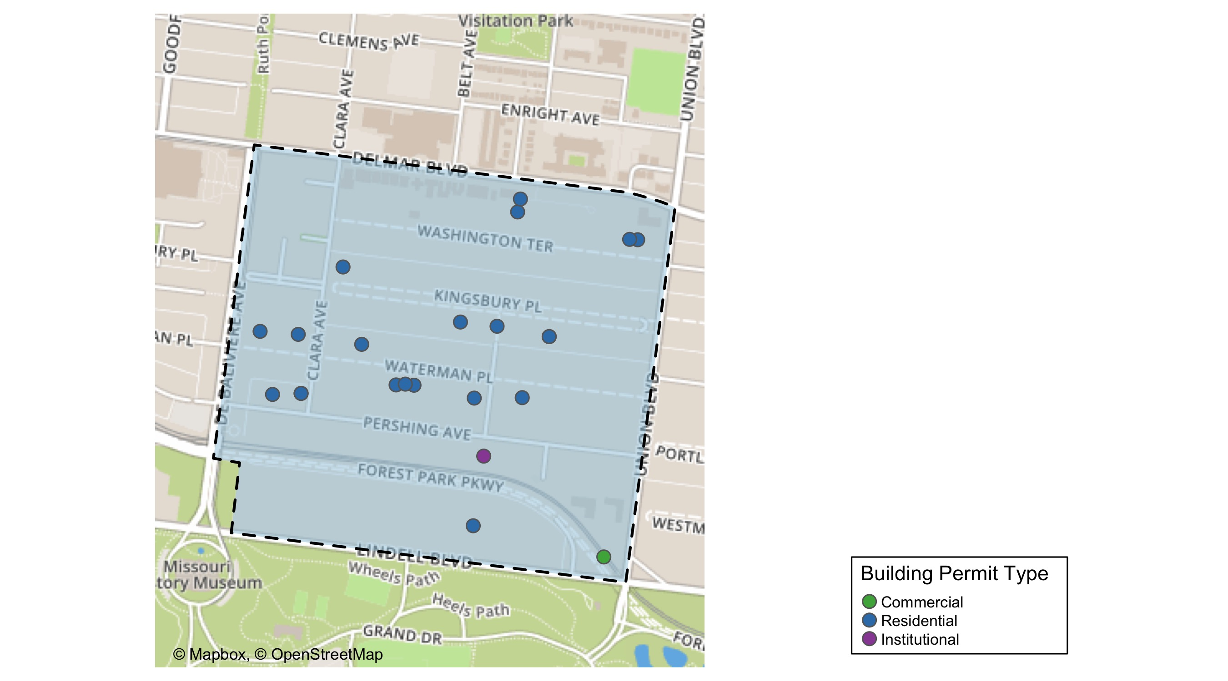
DeBaliviere Place

Slide 22
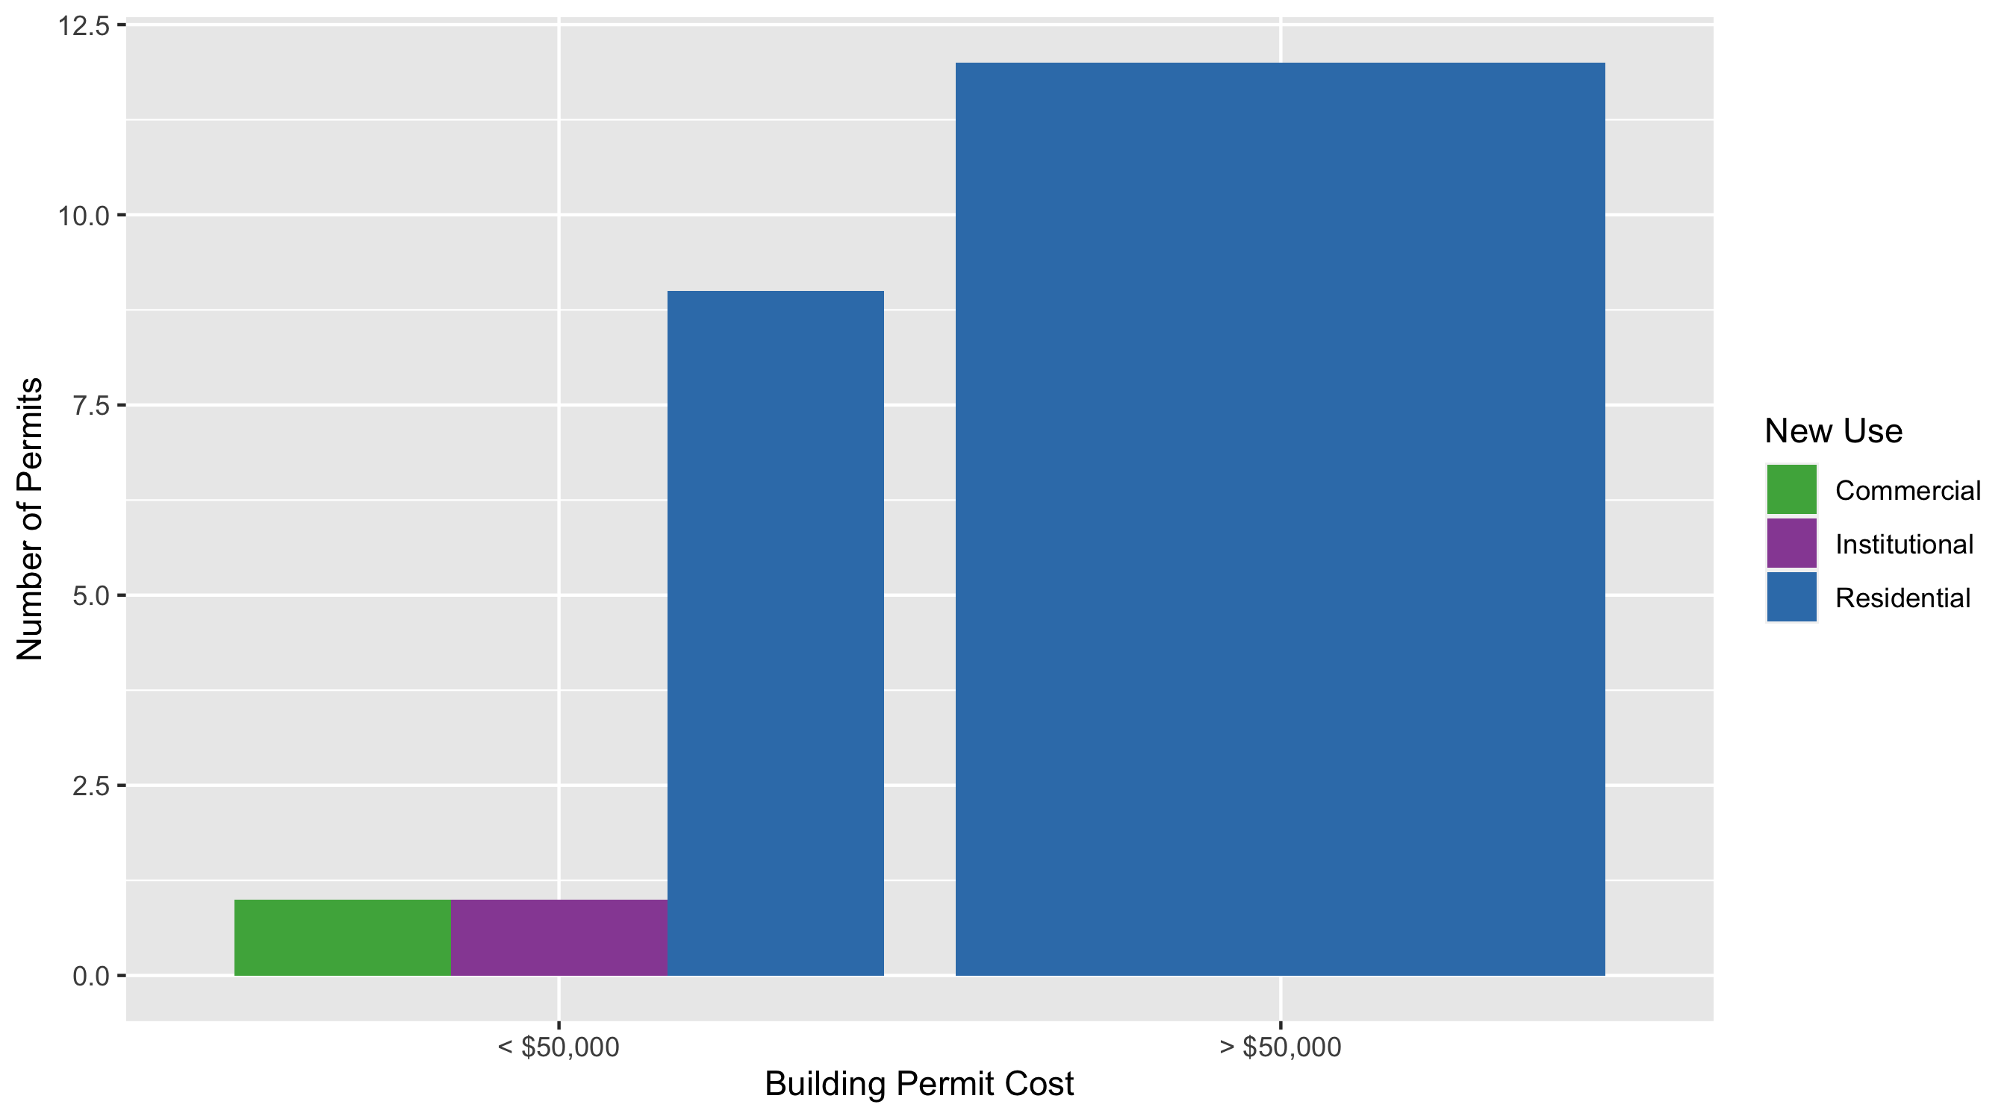
DeBaliviere Place Permit Use Breakdown

Slide 23
DeBaliviere Place
Quarter 3, 2020 | Quarter 3, 2020 | Quarter 3, 2020 | Quarter 3, 2020
Permit Use | Average Cost | # of Permits | Total Value of Permits
Commercial | $780 | 1 | $780
Industrial | $0 | 0 | $0
Institutional | $400 | 1 | $400
Residential | $546,605 | 21 | $11,478,711
Quarter 3 2019 | Quarter 3 2019 | Quarter 3 2019 | Quarter 3 2019
Permit Use | Average Cost | # of Permits | Total Value of Permits
Commercial | $0 | 0 | $0
Industrial | $0 | 0 | $0
Institutional | $51,500 | 2 | $103,000
Residential | $62,618 | 12 | $751,417

Slide 24
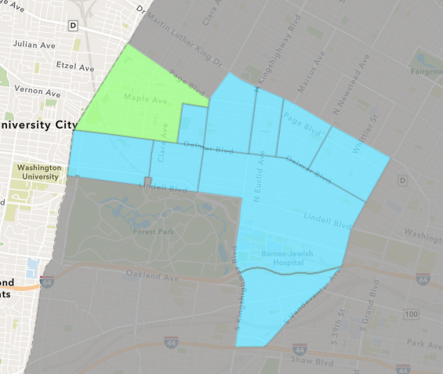
West End
Quarter 3 , 2020 Neighborhood Cost Breakdown
Mean: $71,314
Median: $8,000
Range: $600 - $1,000,000

Slide 25
West End: Summary Notes
24 building permits in Quarter 3, 2020
14.29% change compared to Quarter 3, 2019 (21 total building permits)
$71,314: Average building permit cost in Quarter 3, 2020
-46.35% change compared to Quarter 3, 2019 ($132,936)

Slide 26
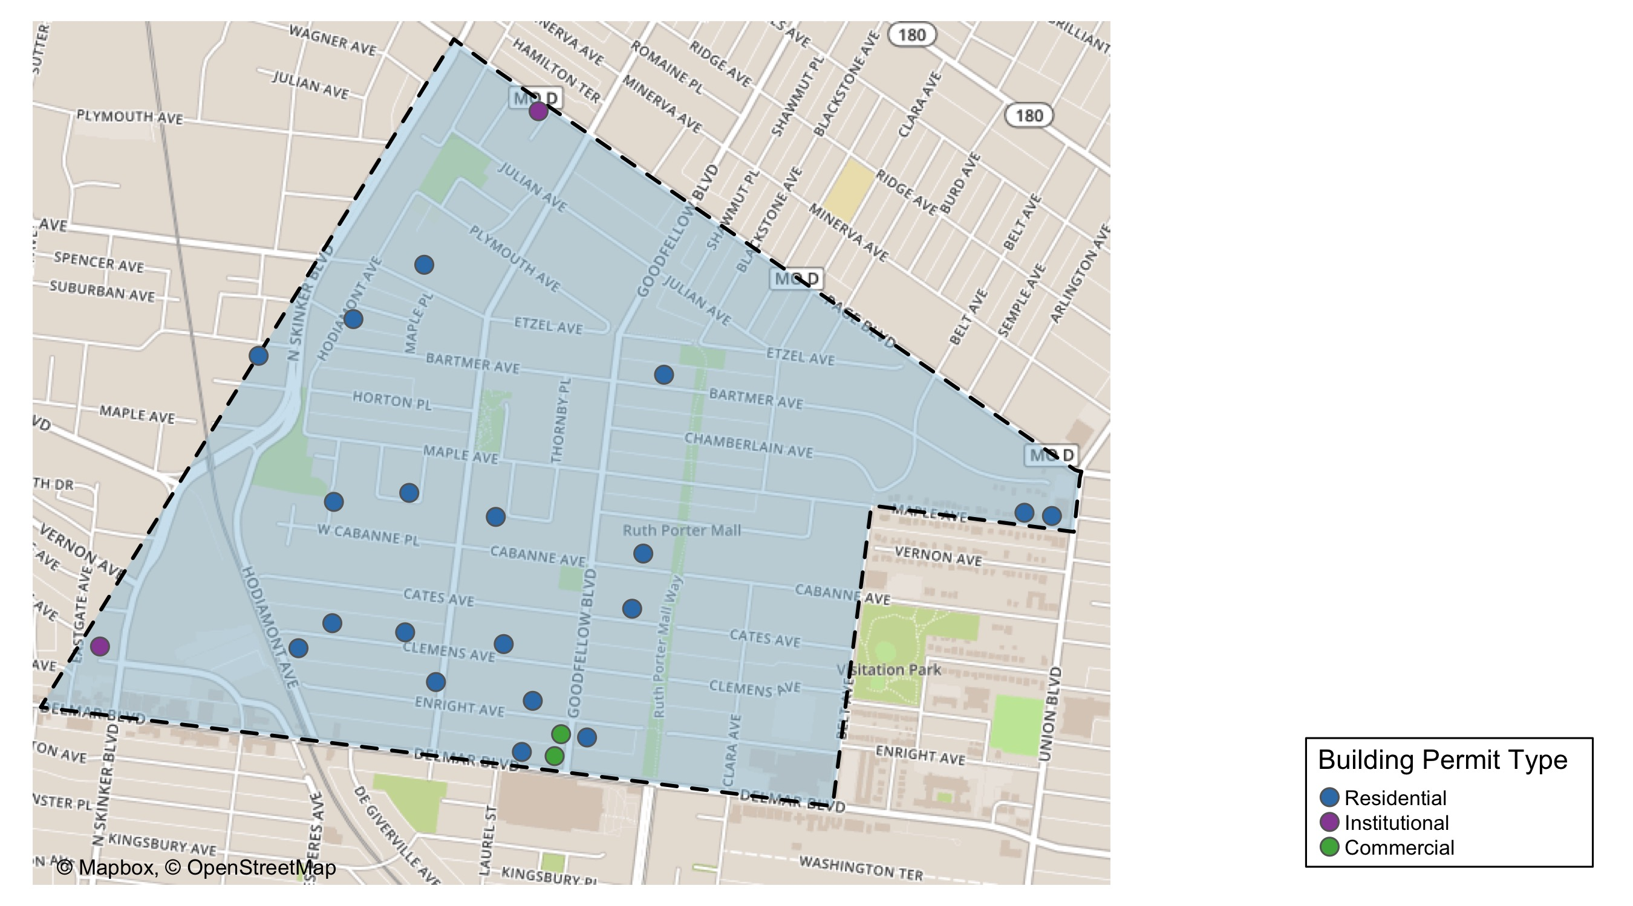
West End

Slide 27
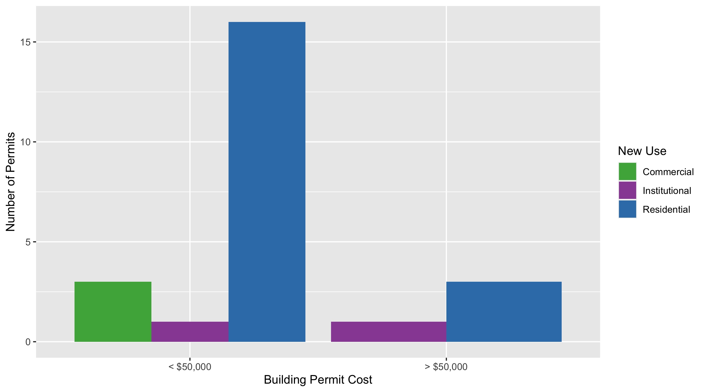
West End Permit Use Breakdown

Slide 28
West End
Quarter 3, 2020 | Quarter 3, 2020 | Quarter 3, 2020 | Quarter 3, 2020
Permit Use | Average Cost | # of Permits | Total Value of Permits
Commercial | $3,444 | 3 | $10,332
Industrial | $0 | 0 | $0
Institutional | $521,018 | 2 | $1,042,035
Residential | $34,693 | 19 | $659,166
Quarter 3 2019 | Quarter 3 2019 | Quarter 3 2019 | Quarter 3 2019
Permit Use | Average Cost | # of Permits | Total Value of Permits
Commercial | $10,500 | 2 | $21,000
Industrial | $30,000 | 1 | $30,000
Institutional | $638,935 | 3 | $1,916,806
Residential | $54,924 | 15 | $823,856

Slide 29
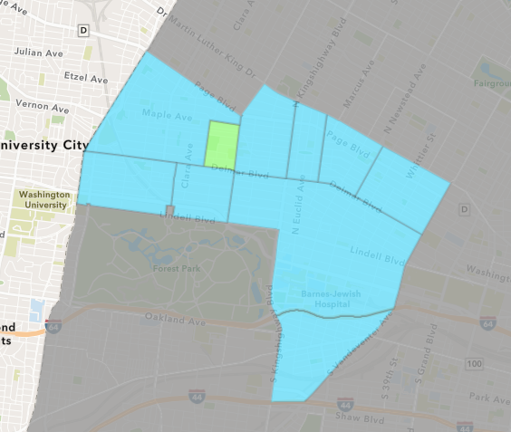
Visitation Park
Quarter 3 , 2020 Neighborhood Cost Breakdown
Mean: $22,051
Median: $8,200
Range: $6,261 - $65,544

Slide 30
Visitation Park: Summary Notes
4 building permits in Quarter 3, 2020
300.00% change compared to Quarter 3, 2019 (1 total building permits)
$22,051: Average building permit cost in Quarter 3, 2020
175.64% change compared to Quarter 3, 2019 ($8,000)

Slide 31
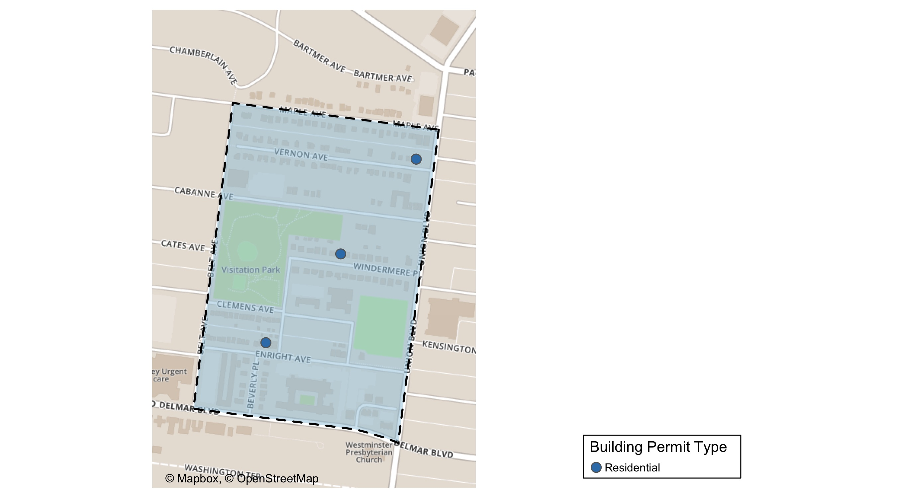
Visitation Park

Slide 32
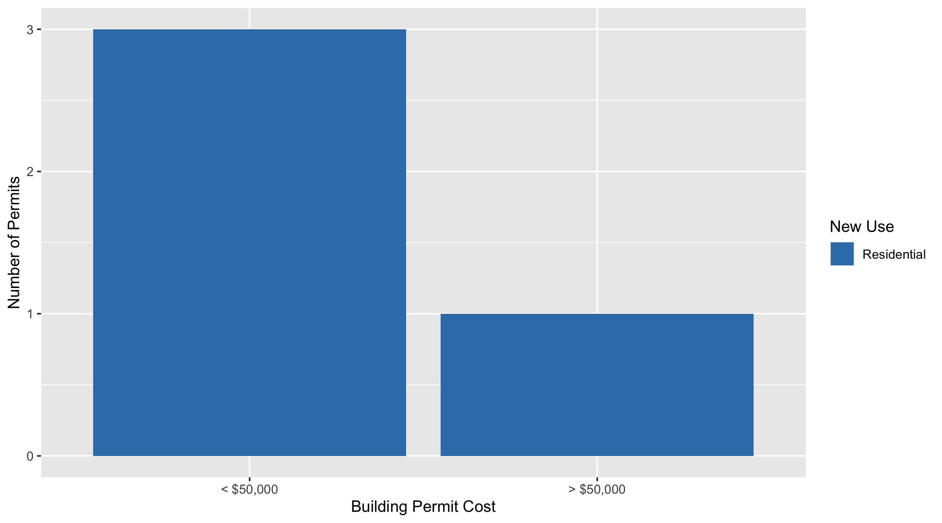
Visitation Park Permit Use Breakdown

Slide 33
Visitation Park
Quarter 3, 2020 | Quarter 3, 2020 | Quarter 3, 2020 | Quarter 3, 2020
Permit Use | Average Cost | # of Permits | Total Value of Permits
Commercial | $0 | 0 | $0
Industrial | $0 | 0 | $0
Institutional | $0 | 0 | $0
Residential | $22,051 | 4 | $88,205
Quarter 3 2019 | Quarter 3 2019 | Quarter 3 2019 | Quarter 3 2019
Permit Use | Average Cost | # of Permits | Total Value of Permits
Commercial | $0 | 0 | $0
Industrial | $0 | 0 | $0
Institutional | $0 | 0 | $0
Residential | $8,000 | 1 | $8,000

Slide 34
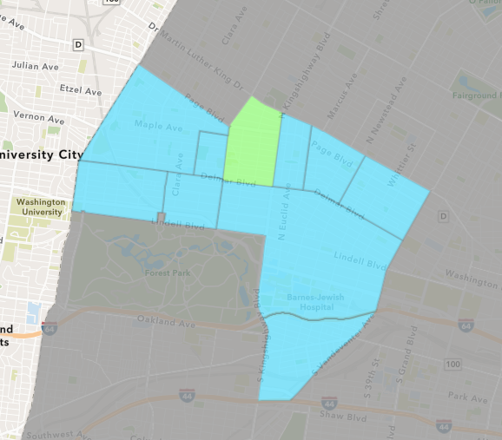
Academy
Quarter 3 , 2020 Neighborhood Cost Breakdown
Mean: $25,616
Median: $6,000
Range: $200 - $150,000

Slide 35
Academy: Summary Notes
14 building permits in Quarter 3, 2020
16.67% change compared to Quarter 3, 2019 (12 total building permits)
$25,616: Average building permit cost in Quarter 3, 2020
-41.99% change compared to Quarter 3, 2019 ($44,154)

Slide 36
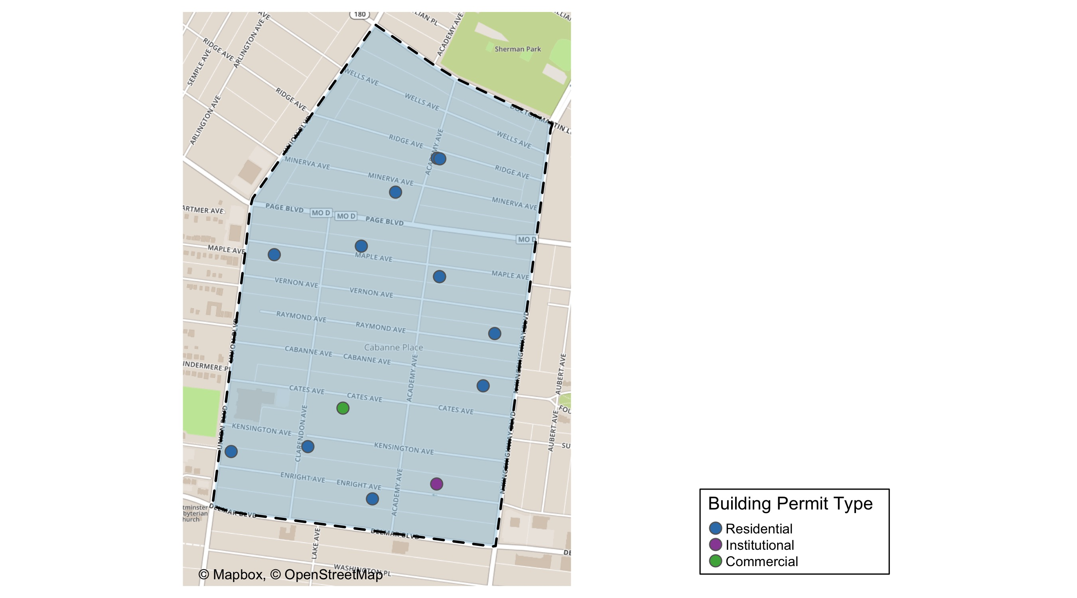
Academy

Slide 37
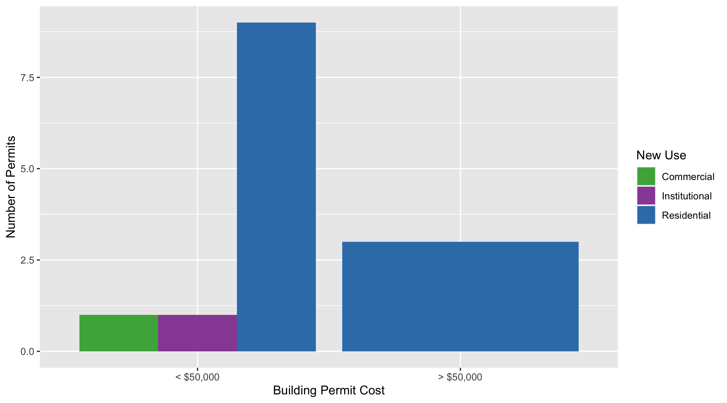
Academy Permit Use Breakdown

Slide 38
Academy
Quarter 3, 2020 | Quarter 3, 2020 | Quarter 3, 2020 | Quarter 3, 2020
Permit Use | Average Cost | # of Permits | Total Value of Permits
Commercial | $10,000 | 1 | $10,000
Industrial | $0 | 0 | $0
Institutional | $5,000 | 1 | $5,000
Residential | $28,635 | 12 | $343,620
Quarter 3 2019 | Quarter 3 2019 | Quarter 3 2019 | Quarter 3 2019
Permit Use | Average Cost | # of Permits | Total Value of Permits
Commercial | $2,950 | 3 | $8,850
Industrial | $0 | 0 | $0
Institutional | $150,000 | 2 | $300,000
Residential | $31,571 | 7 | $221,000

Slide 39
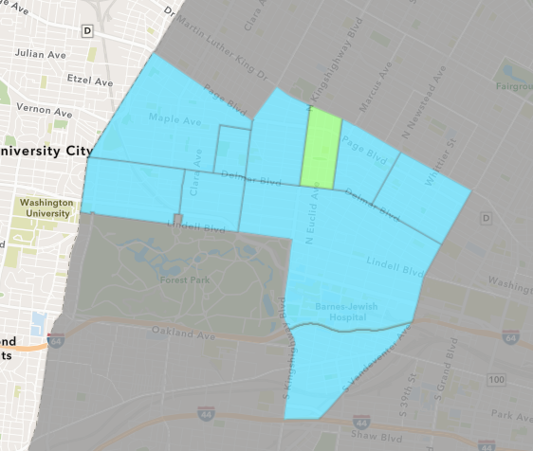
Fountain Park
Quarter 3 , 2020 Neighborhood Cost Breakdown
Mean: $175,000
Median: $175,000
Range: $175,000 - $175,000

Slide 40
Fountain Park: Summary Notes
1 building permits in Quarter 3, 2020
-75.00% change compared to Quarter 3, 2019 (4 total building permits)
$175,000: Average building permit cost in Quarter 3, 2020
444.05% change compared to Quarter 3, 2019 ($32,166)

Slide 41
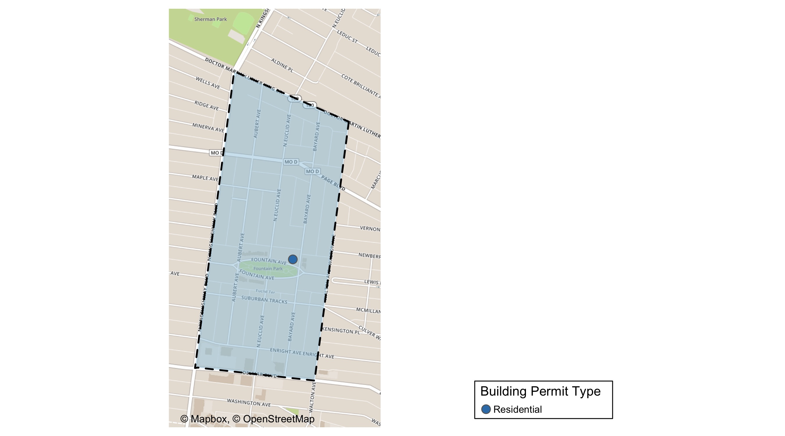
Fountain Park

Slide 42
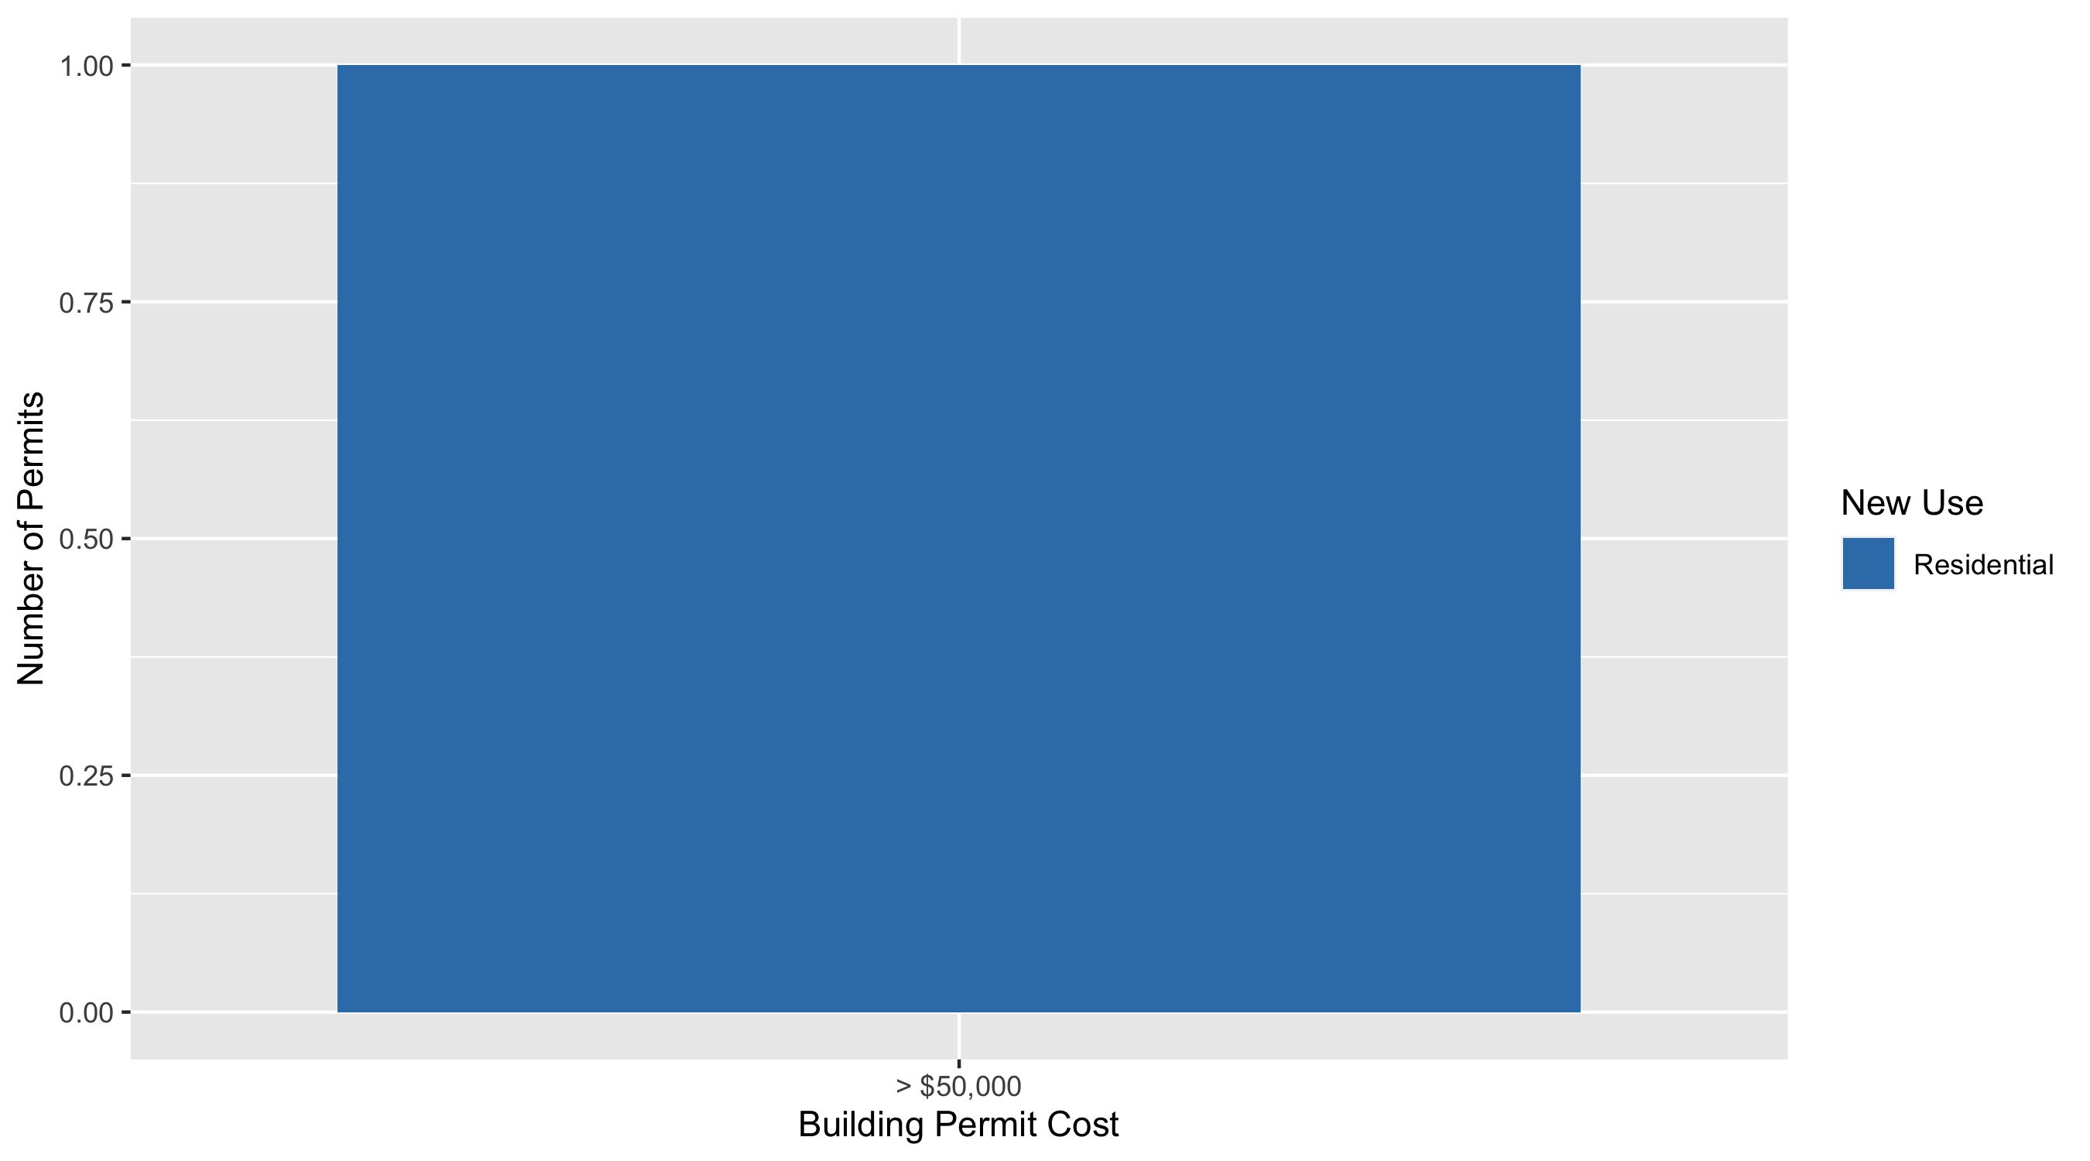
Fountain Park Permit Use Breakdown

Slide 43
Fountain Park
Quarter 3, 2020 | Quarter 3, 2020 | Quarter 3, 2020 | Quarter 3, 2020
Permit Use | Average Cost | # of Permits | Total Value of Permits
Commercial | $0 | 0 | $0
Industrial | $0 | 0 | $0
Institutional | $0 | 0 | $0
Residential | $175,000 | 1 | $175,000
Quarter 3 2019 | Quarter 3 2019 | Quarter 3 2019 | Quarter 3 2019
Permit Use | Average Cost | # of Permits | Total Value of Permits
Commercial | $13,082 | 2 | $26,165
Industrial | $0 | 0 | $0
Institutional | $0 | 0 | $0
Residential | $51,250 | 2 | $102,500

Slide 44
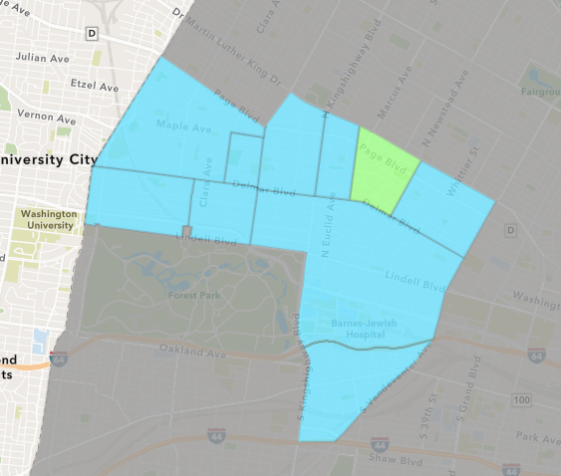
Lewis Place
Quarter 3 , 2020 Neighborhood Cost Breakdown
Mean: $78,826
Median: $9,895
Range: $3,500 - $425,000

Slide 45
Lewis Place: Summary Notes
10 building permits in Quarter 3, 2020
900.00% change compared to Quarter 3, 2019 (1 total building permits)
$78,826: Average building permit cost in Quarter 3, 2020
425.51% change compared to Quarter 3, 2019 ($15,000)

Slide 46
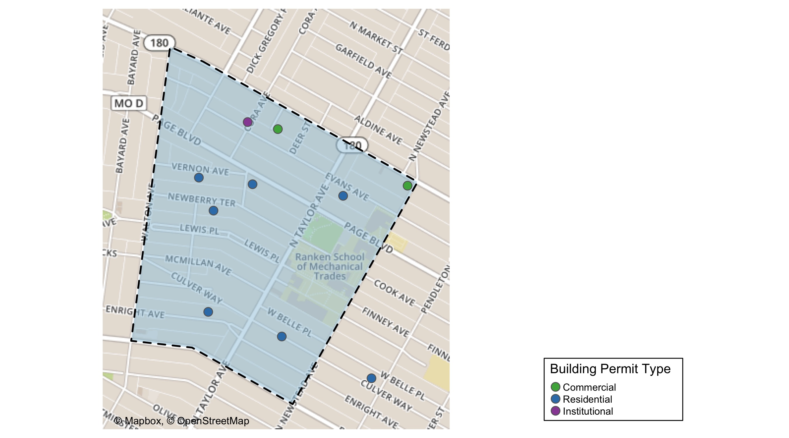
Lewis Place

Slide 47
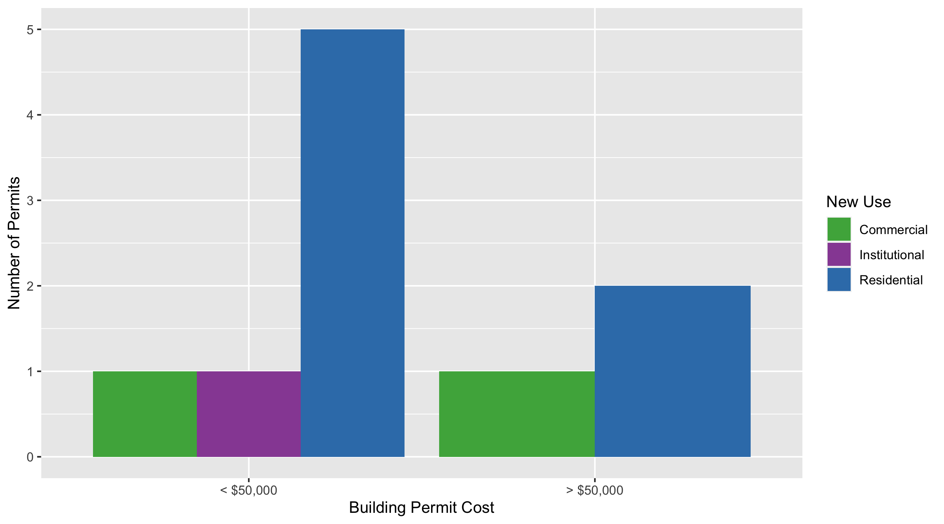
Lewis Place Permit Use Breakdown

Slide 48
Lewis Place
Quarter 3, 2020 | Quarter 3, 2020 | Quarter 3, 2020 | Quarter 3, 2020
Permit Use | Average Cost | # of Permits | Total Value of Permits
Commercial | $217,500 | 2 | $435,000
Industrial | $0 | 0 | $0
Institutional | $10,000 | 1 | $10,000
Residential | $49,037 | 7 | $343,260
Quarter 3 2019 | Quarter 3 2019 | Quarter 3 2019 | Quarter 3 2019
Permit Use | Average Cost | # of Permits | Total Value of Permits
Commercial | $15,000 | 1 | $15,000
Industrial | $0 | 0 | $0
Institutional | $0 | 0 | $0
Residential | $0 | 0 | $0

Slide 49
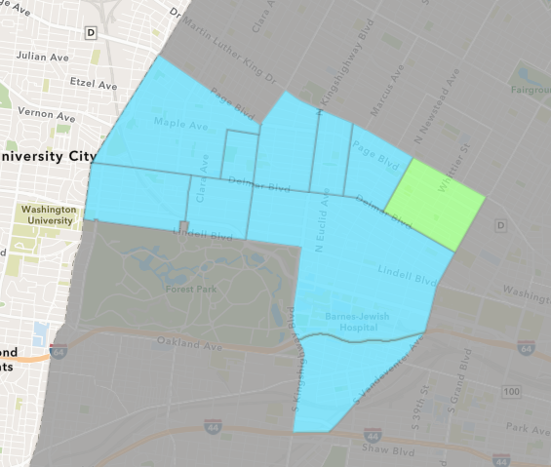
Vandeventer
Quarter 3 , 2020 Neighborhood Cost Breakdown
Mean: $54,550
Median: $13,000
Range: $5,649 - $145,000

Slide 50
Vandeventer: Summary Notes
3 building permits in Quarter 3, 2020
-66.67% change compared to Quarter 3, 2019 (9 total building permits)
$54,550: Average building permit cost in Quarter 3, 2020
11.68% change compared to Quarter 3, 2019 ($48,844)

Slide 51
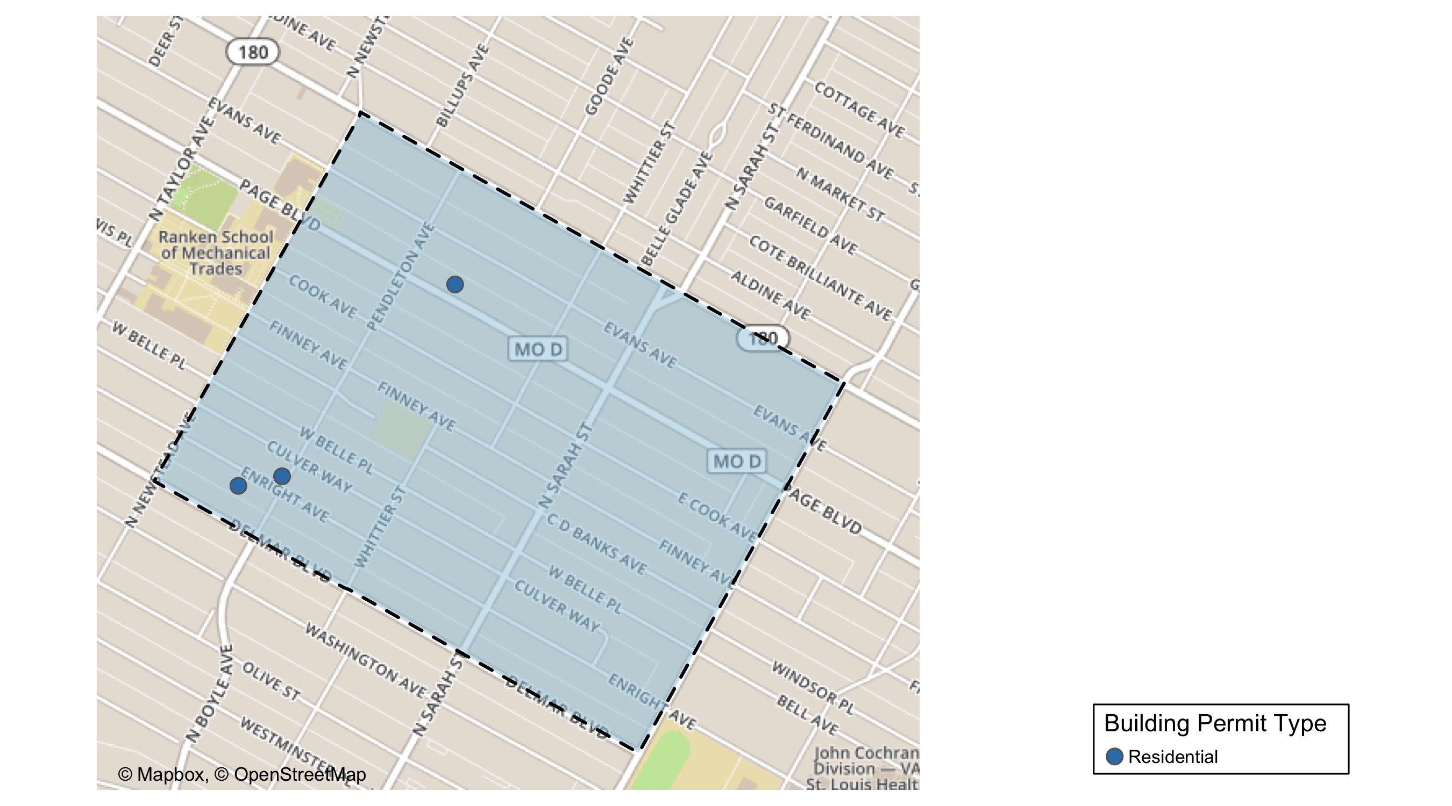
Vandeventer

Slide 52
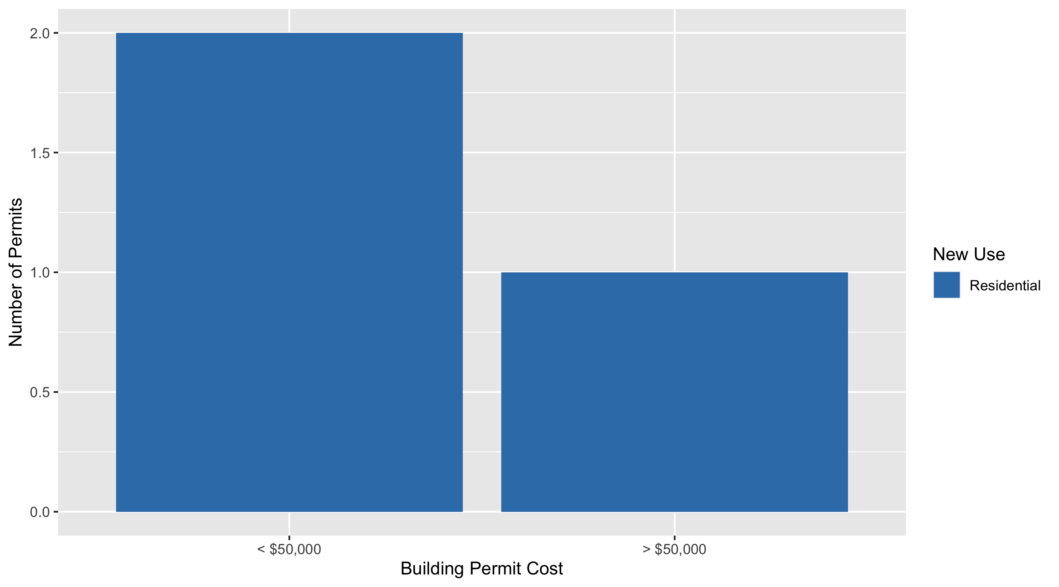
Vandeventer Permit Use Breakdown

Slide 53
Vandeventer
Quarter 3, 2020 | Quarter 3, 2020 | Quarter 3, 2020 | Quarter 3, 2020
Permit Use | Average Cost | # of Permits | Total Value of Permits
Commercial | $0 | 0 | $0
Industrial | $0 | 0 | $0
Institutional | $0 | 0 | $0
Residential | $54,550 | 3 | $163,649
Quarter 3 2019 | Quarter 3 2019 | Quarter 3 2019 | Quarter 3 2019
Permit Use | Average Cost | # of Permits | Total Value of Permits
Commercial | $1,000 | 1 | $1,000
Industrial | $0 | 0 | $0
Institutional | $101,000 | 1 | $101,000
Residential | $48,229 | 7 | $337,600

Slide 54
Additional Notes
Data retreived from https://www.stlouis-mo.gov/data/
Building permits with a cost of $0 were dropped
Building permits that were cancelled were dropped
Infinite change indicates 0 permits in the current or previous time period/comparison month so there was a overall increase or decrease

